Slide 1

FitHub
Presented by
Pankaj Kumar (22223055)
Manav Jain (22223045)
MCA-V Semester
Dr. Dibakar Saha
Supervisor

Slide 2
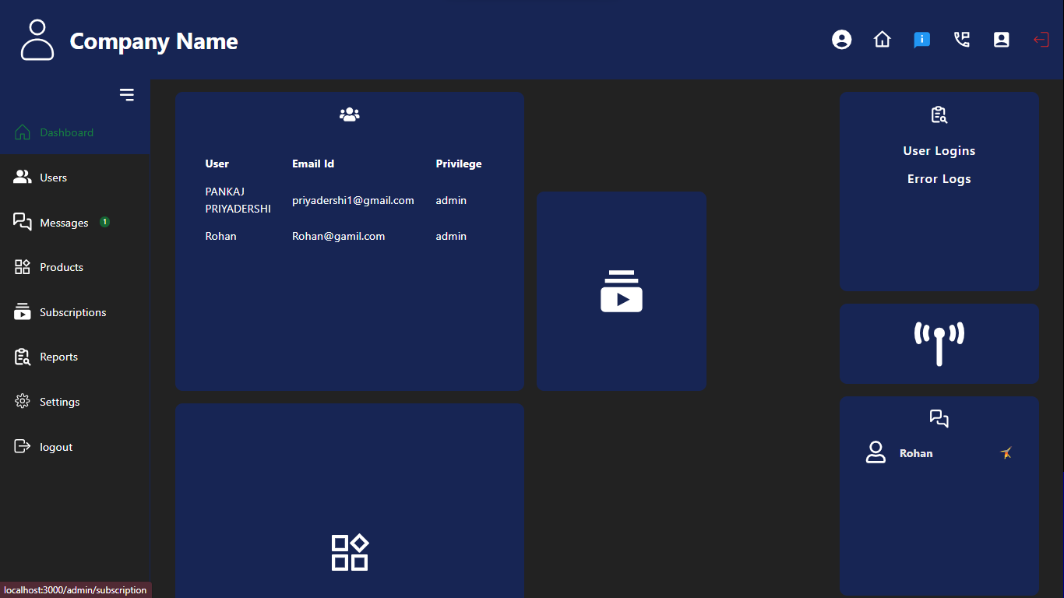
What is FitHub?
It is Multi-purpose Customer Relationship Management (CRM) and Subscription Management System.
System is designed to manage customer data, subscriptions and products.
Admin Panel for efficiently manage customer data, product offerings and subscription plans
User Panel for Customer Interactions
Dashboard

Slide 3



Existing Models
Popular CRM Models: Salesforce, HubSpot, and Zoho CRM.
Limitations: Not designed specifically for businesses with subscriptions; they also lack built-in real-time messaging.
FitHub Combines all three — CRM, subscription tracking, and real-time messaging — in one platform for subscription-based businesses.

Slide 4

Research Background
Customer Engagement:
Studies show real-time messaging boosts customer satisfaction and loyalty.
Subscription Management:
Clear renewal options lead to higher retention.
FitHub’s Advantage:
Integrates CRM, subscriptions, and messaging for an all-in-one solution.

Slide 5

Motivation & Application
Simplifies customer management and subscription tracking for businesses.
Companies and Institutions face challenges in managing customer interactions, subscriptions, and communications efficiently.
Provides one stop solution to all.

Slide 6



Motivation & Application
This Platform can be utilized by –
Gyms and Fitness centers
Manage member subscriptions tracking, attendance, direct communication
Healthcare Clinics
Appointments, health plans, reminders.
Educational Institutions
student enrollments, track course subscriptions, and communication.
…etc

Slide 7
Project Contribuiton
Unified Platform: Combines CRM, subscription management, and messaging in one system.
Real-Time Communication: Enables quick responses to customers, improving satisfaction.
Clear Subscription Tracking: Gives customers easy access to subscription details.
Efficiency: Reduces need for multiple tools, saving time for admins.
Scalability: Built to grow with the business.

Slide 8


Methodology
System Design:
Designed a user-friendly interface with React for the client side.
Created a backend with Node.js and Express for handling data requests and updates.
Database Setup:
Used MongoDB to store customer profiles, subscription details, and messages.
Organized data to ensure quick access and easy updates.

Slide 9

Methodology
Real-Time Messaging:
Integrated socket.io to support live chat between admins and customers.
Testing and Feedback:
Tested each feature individually and as part of the whole system.
Gathered user feedback to improve functionality and make the system easy to use.

Slide 10
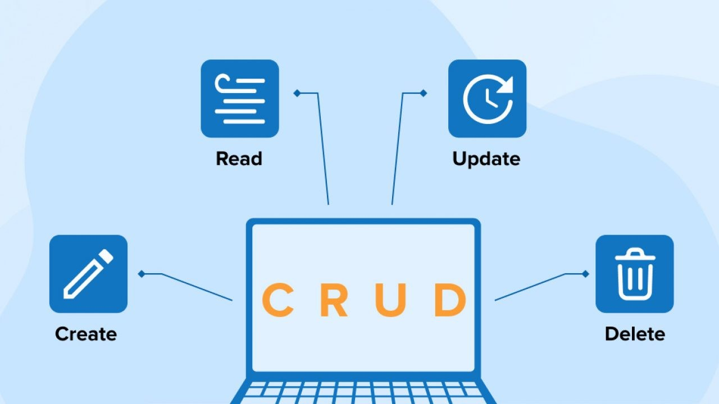
Algorithm
Customer Data Operations:
Used CRUD functions for adding, viewing, updating, and deleting customer profiles.
Subscription Tracking
Data Validation:
Validates customer details (e.g., email format) to ensure accurate information is stored.

Slide 11

Algorithm
Real-Time Message Queue:
Stores and organizes each message for timely delivery and reliable record-keeping.
Socket Communication:
Socket.io establishes a live connection for instant messaging between admins and customers.

Slide 12
Design
Used React to provide a responsive and modern interface.
Simple navigation for quick access to customer data and services.
Used Tailwind CSS for a clean, professional look, colors, and animations.

Slide 13
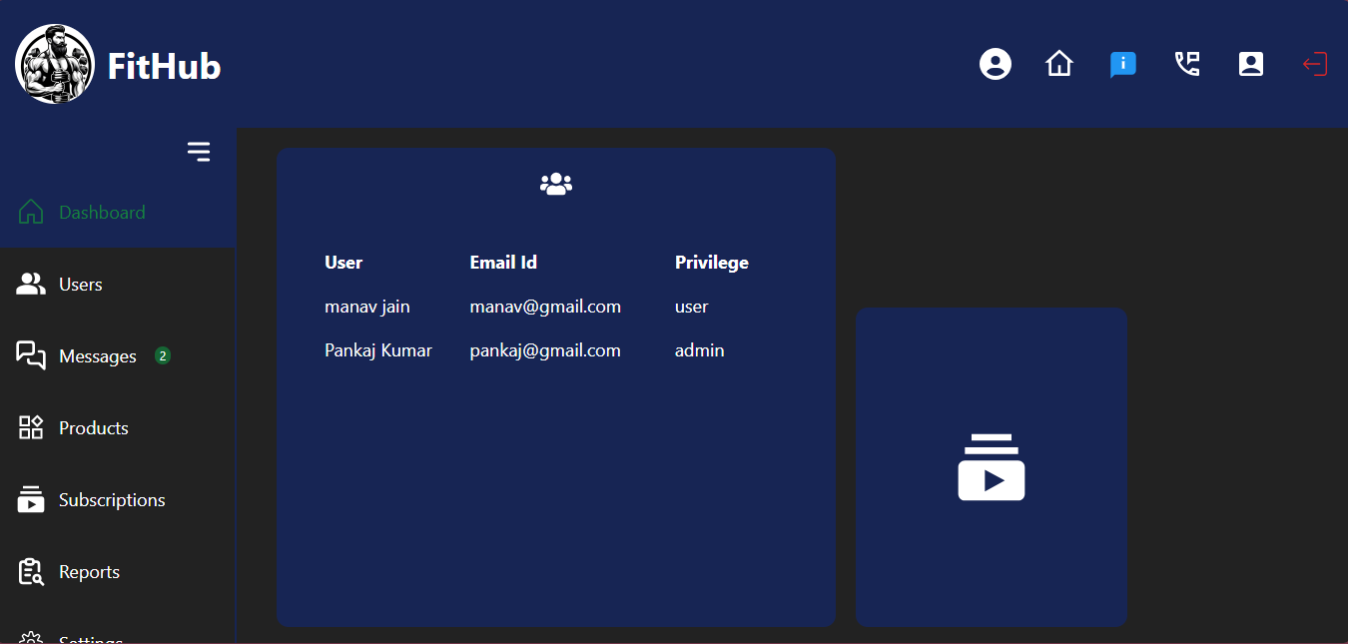
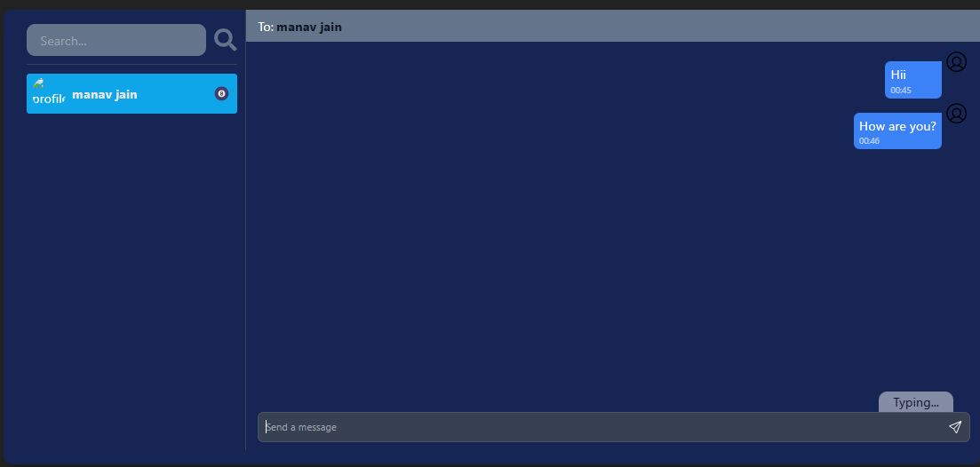
Proposed Model
Admin Panel
Dashboard (customer data, subscription and analytics).
Tools for product management, customer support, and communication.
Broadcast and Individual chats.
User Panel
Interface for customers to manage subscriptions and interact with admin via inbuilt chat.
Messaging Interface:
Real-time chat window integrated into the dashboard for easy communication.
Admin Panel
Massaging Service

Slide 14
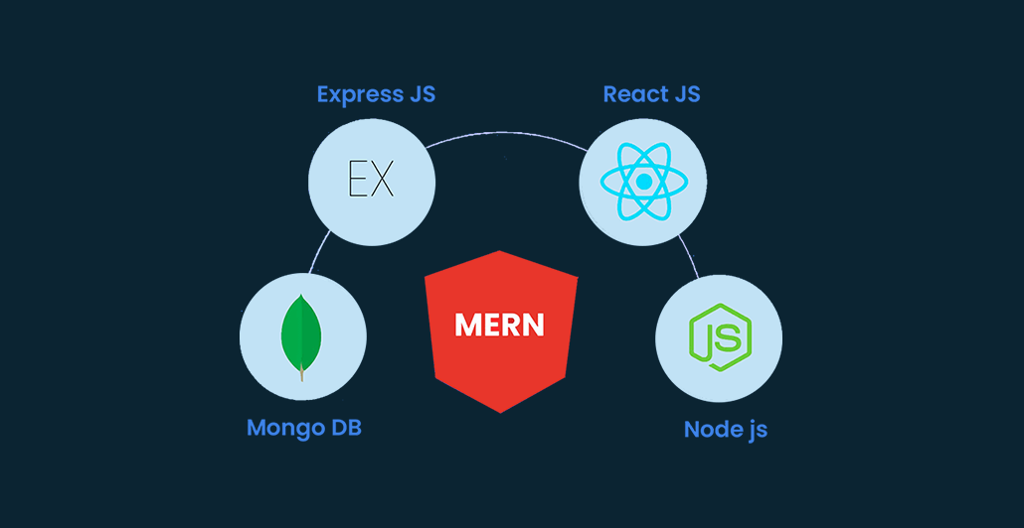
Technology Stack –
Frontend: React.js, Tailwind CSS
Backend: Node.js, Express
Database: MongoDB
Realtime Communication: Socket.io

Slide 15
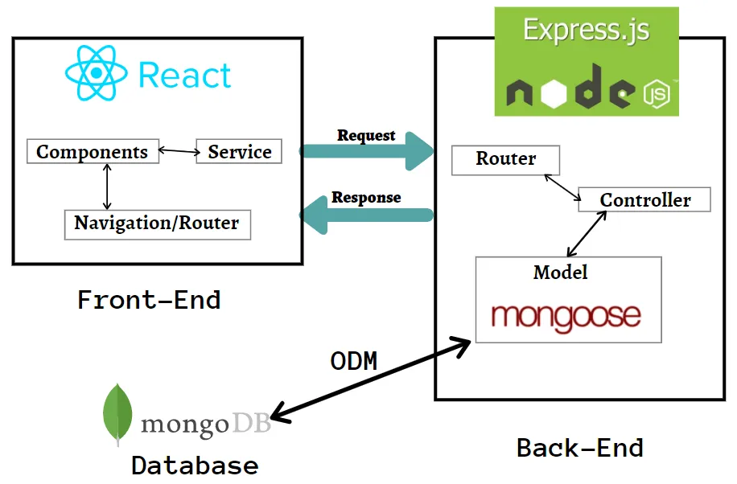
Architecture
Fithub
User Management
Product Management
Message management
Authentication & Authorisation
User Database

Slide 16
Expected outcomes
Enhanced Customer Management:
FitHub enables efficient tracking of customer details, subscriptions, and communication history, improving overall customer relationship management.
Real-Time Engagement:
Instant messaging with customers enhances satisfaction& better customer retention.
Streamlined Operations:
The all-in-one platform reduced the need for multiple tools simplifying workflows.
Scalability:
Designed on the MERN stack, the system can scale to handle more users and data as the business grows, ensuring long-term usability.

Slide 17
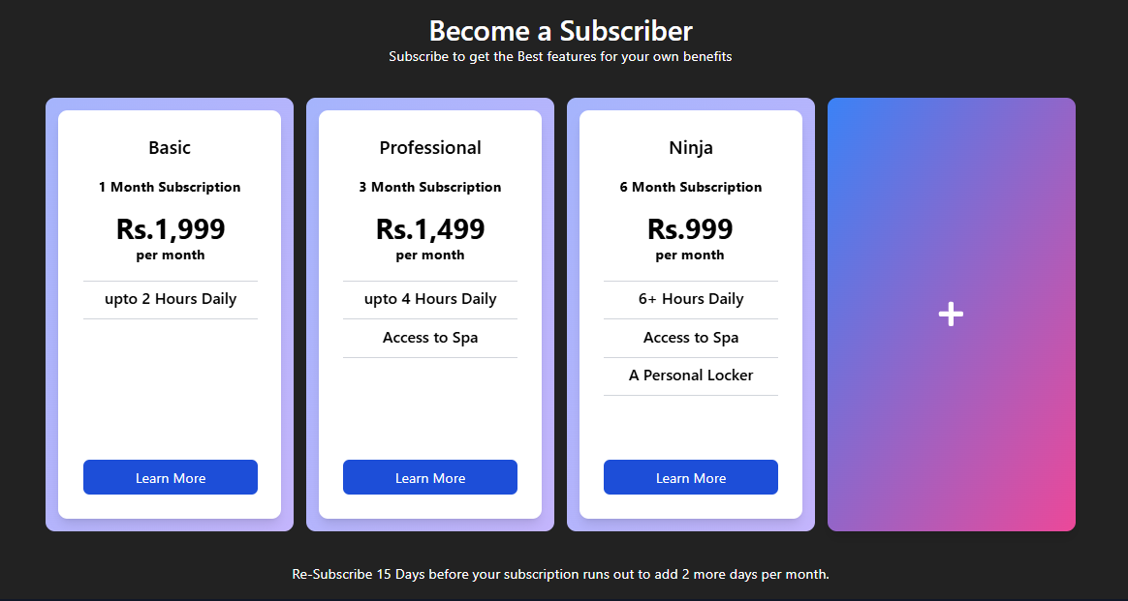
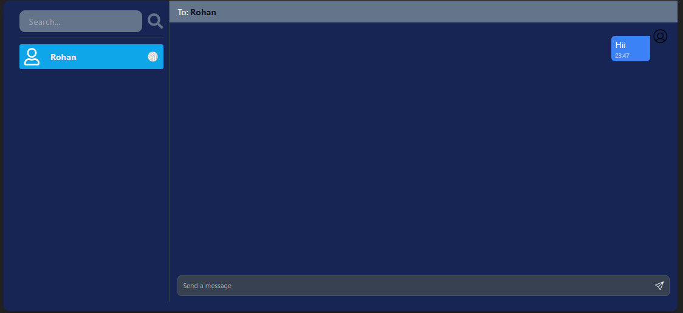
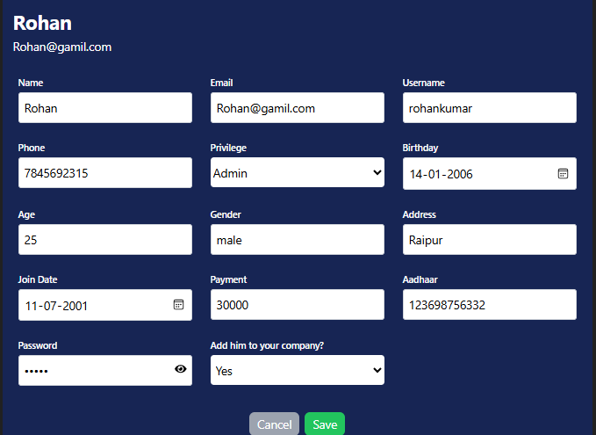
Pages
Messaging Service

Slide 18

Challenges Faced
Real-Time Messaging:
Ensuring fast and reliable message delivery.
Subscription Complexity:
Managing diverse subscription models and integrating them with user profiles in a seamless way.
Data Synchronization:
Keeping data up-to-date across the platform in real-time, especially for subscriptions and customer interactions.
Scalability:
Designing the system to handle increasing user base and data without performance issues.

Slide 19
Key Learnings
Real-Time Interaction:
Adding real-time communication enhances customer engagement.
Unified Approach:
Combining CRM, subscription management, and messaging in one system.
User-Centric Design:
A clean, intuitive UI/UX significantly improves user adoption and reduces the learning curve for administrators.
Data Integrity:
Ensuring accurate and consistent data flow across the platform.

Slide 20
Project Impact
Customer Retention:
The integrated messaging system helps build stronger relationships.
Operational Efficiency:
Reducing the need for multiple disconnected tools makes operations smoother.
Business Growth:
The scalable architecture supports future growth and the addition of new features.
Unique Selling Point:
FitHub’s combination of CRM, subscription management, and real-time messaging makes it a unique solution for subscription-based businesses.

Slide 21

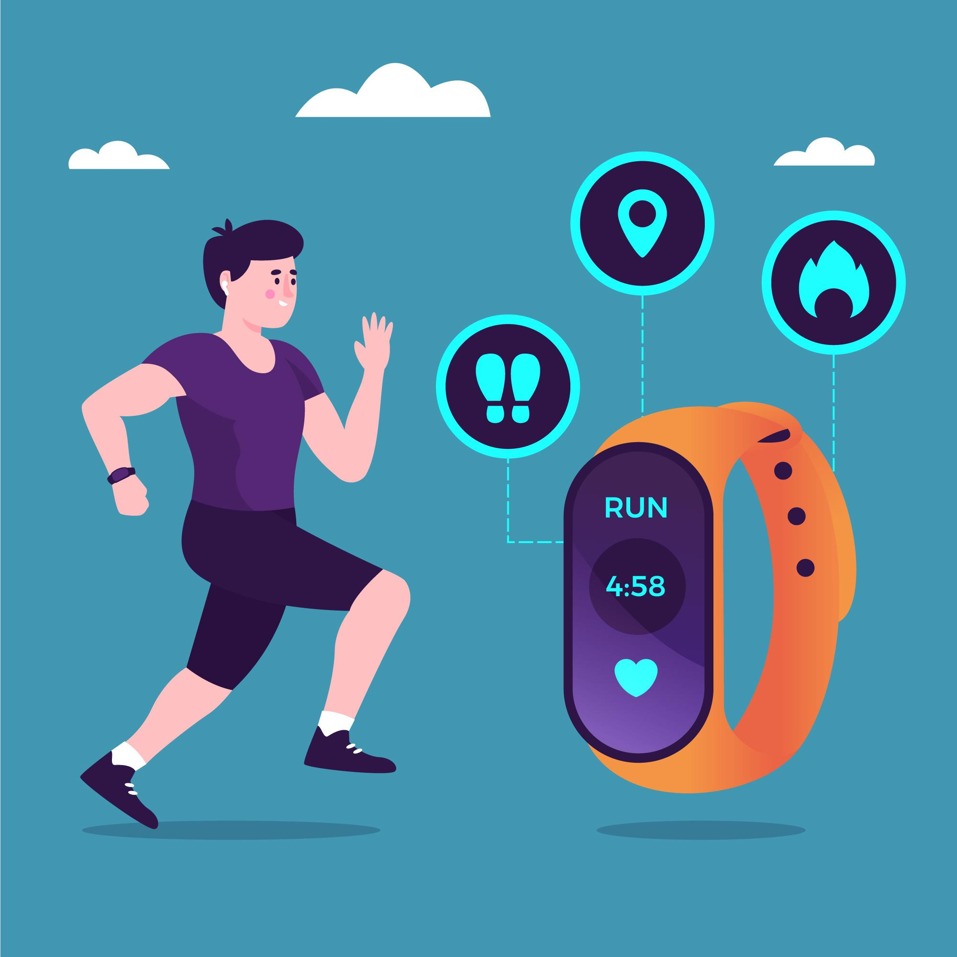

Future Scope
AI Integration
Personalize recommendations & Chat Bot.
Develop mobile app
Daily movement tracking through fitness band.

Slide 22
Thank You!

